Slide 1
Tennis Like the Tennis Pros
(Swing)
Eric Li

Slide 2
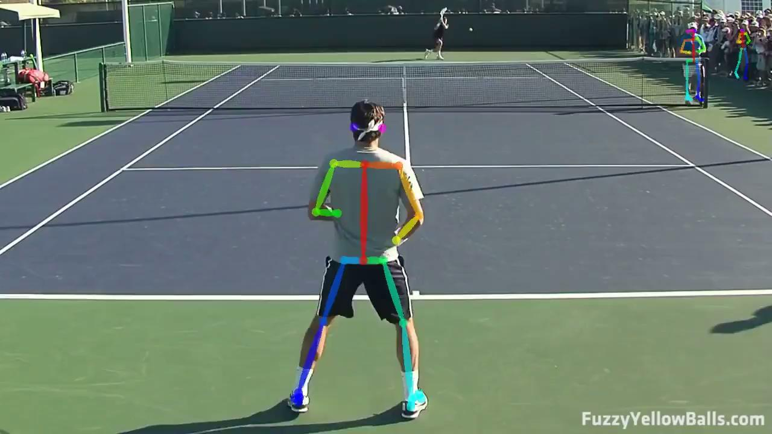
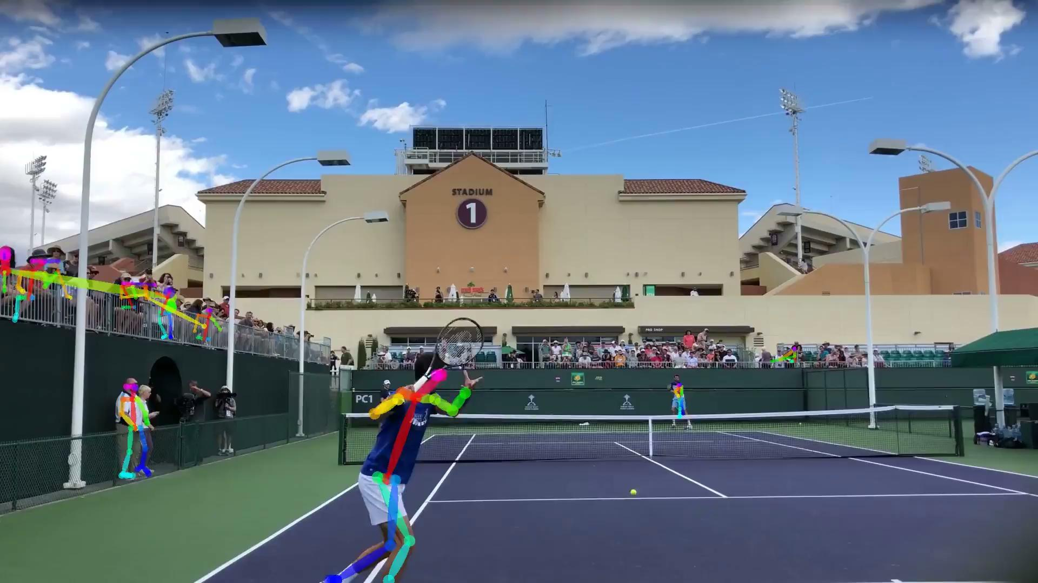
Project Premise
Goal: Identify the pose of tennis professionals during play and allow users to compare their own play with the professionals
Proof of Concept: For now, I’ll focus on forehand arm angles.
Notes:
Should I copy Roger Federer or Rafael Nadal’s technique?
https://www.patcash.co.uk/2019/04/tennis-forehand-technique-straight-arm-vs-bent-arm/
https://www.colesportsresearch.com/home/2018/1/15/what-is-the-advantage-of-a-straight-arm-forehand

Slide 3
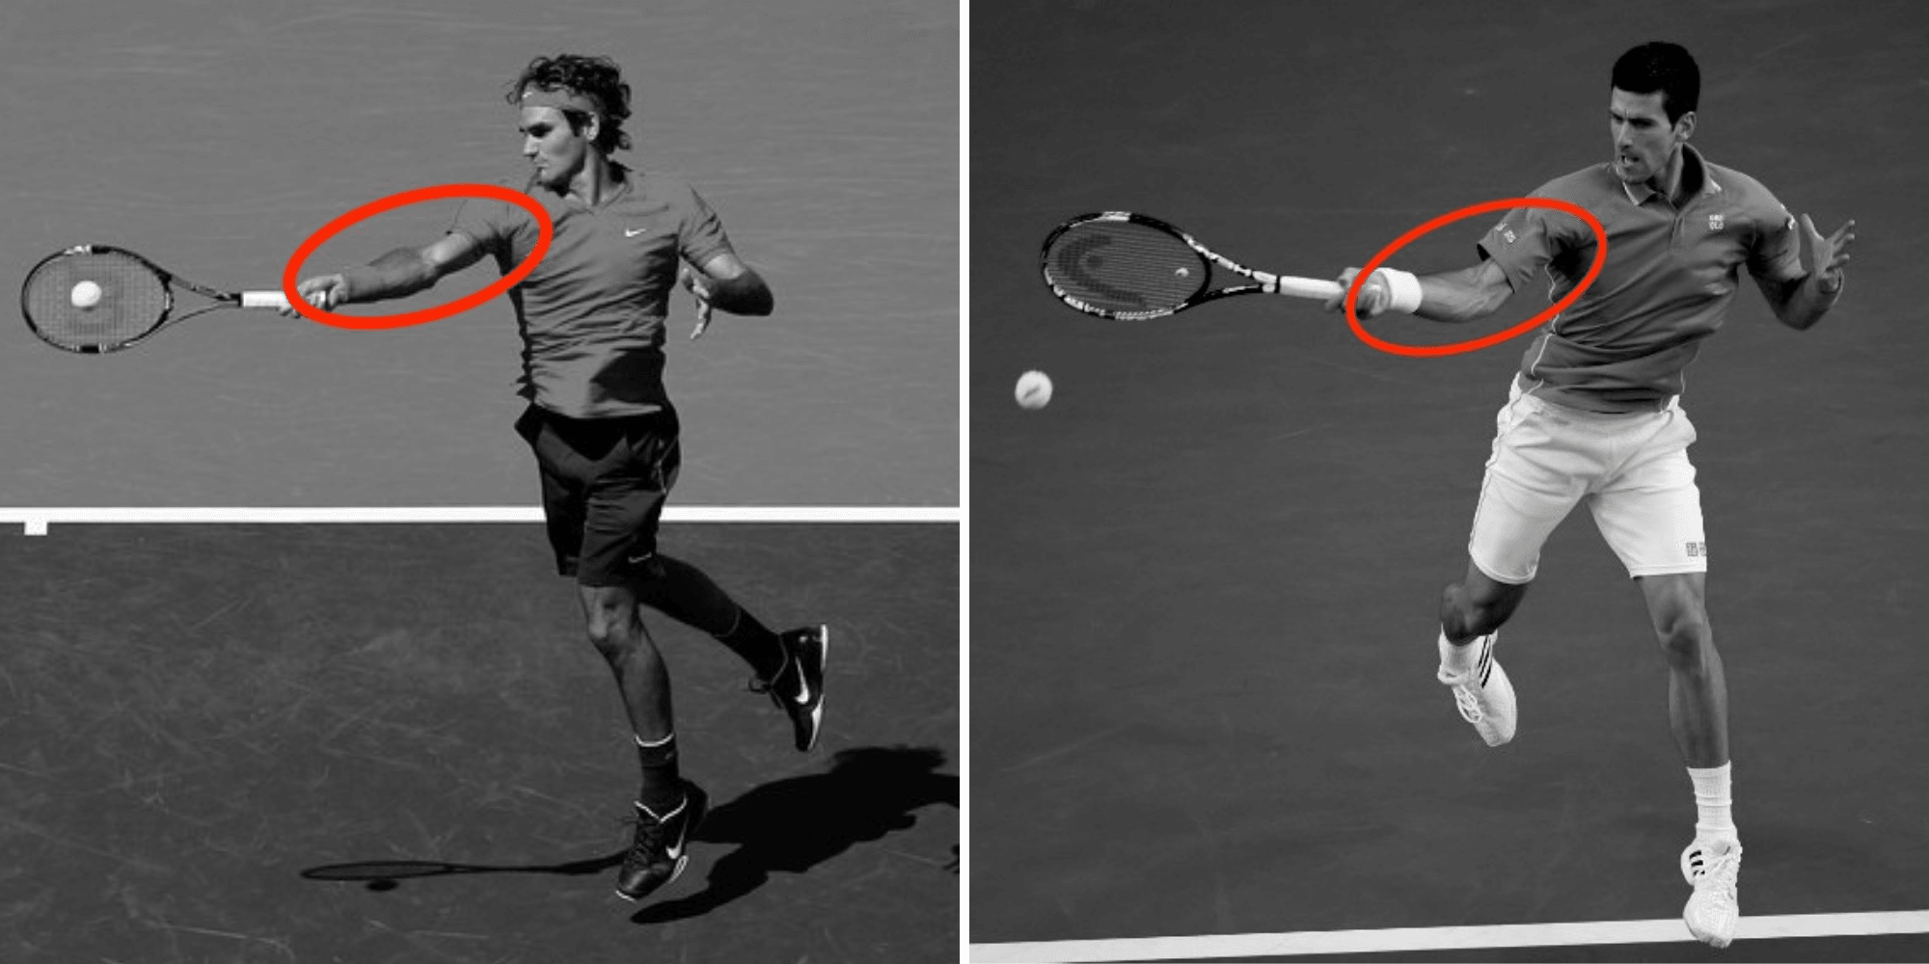
Background: Tennis Forehand Techniques
Straight Arm Forehand
Higher peak speed
Exemplifies good movement and positioning
Requires better timing
Bent Arm Forehand
Contact point closer to core
More control
More flexibility
Greater margin for error
Source: Patcash.co

Slide 4
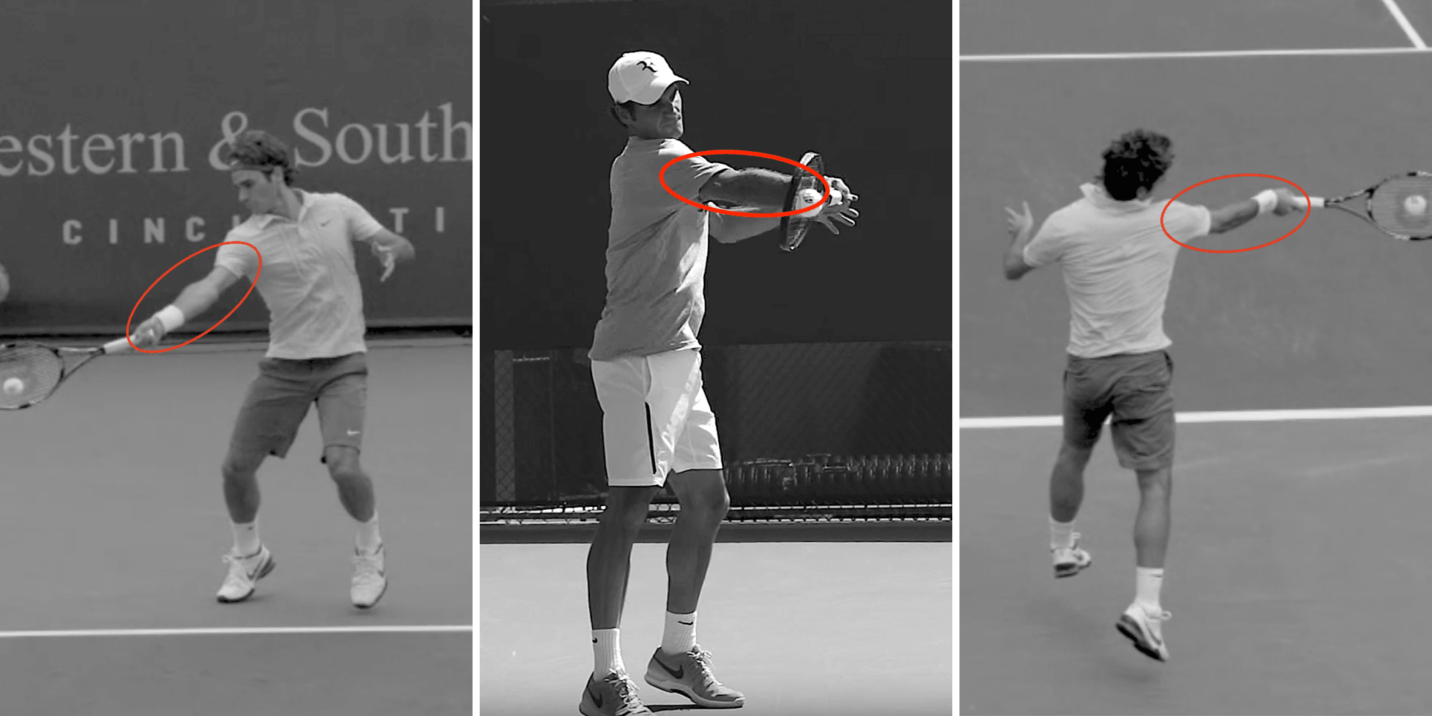
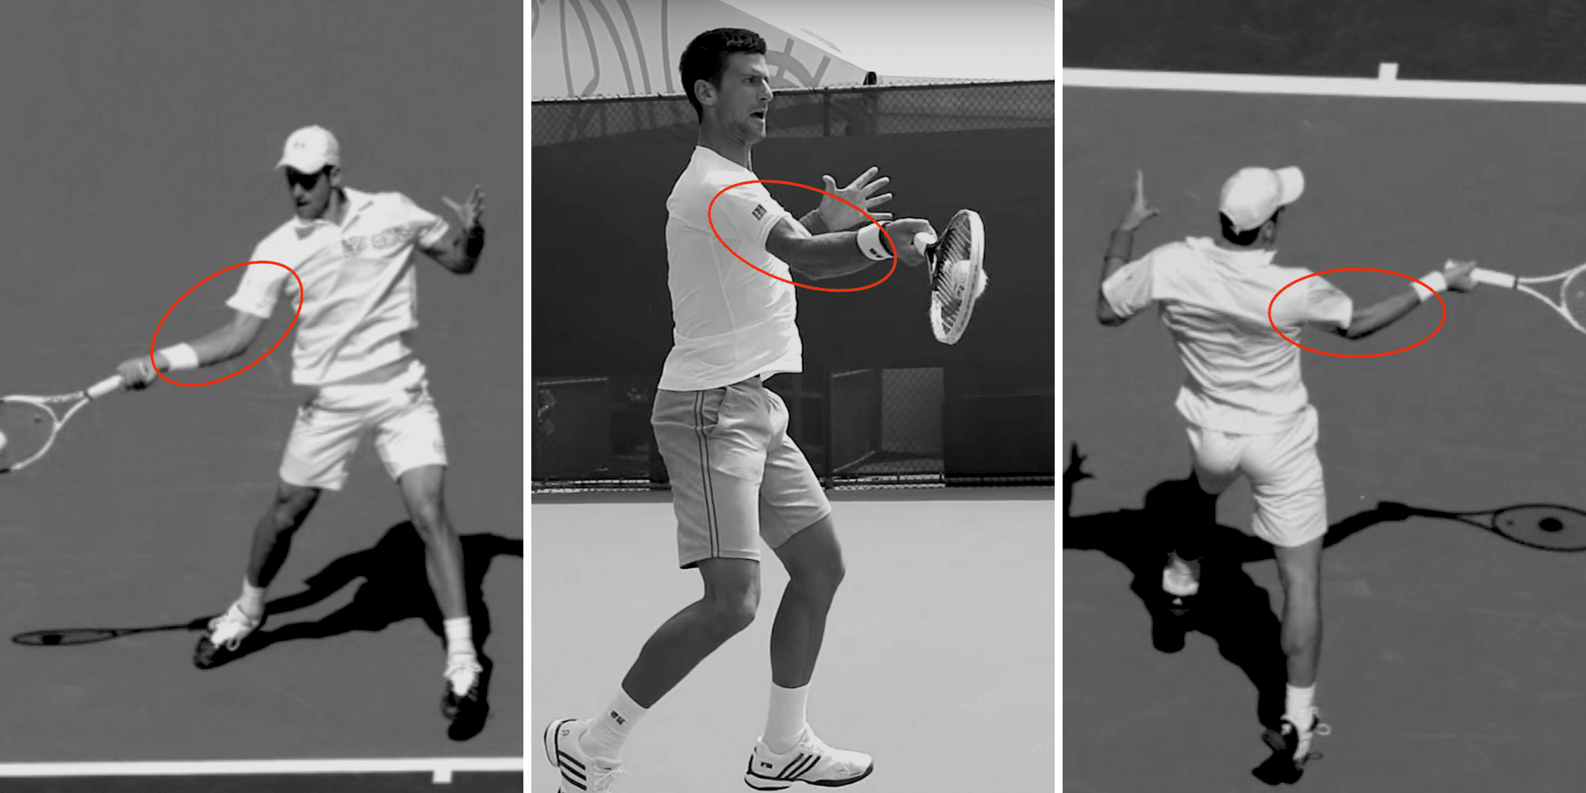
Background: Tennis Forehand Techniques
Straight Arm Forehand
Bent Arm Forehand
Source: Patcash.co
Source: Patcash.co
Roger Federer, Rafael Nadal, Juan Martín del Potro
Novak Djokovic, Andy Murray, Stan Wawrinka, Pete Sampras, Serena Williams, Maria Sharapova

Slide 5
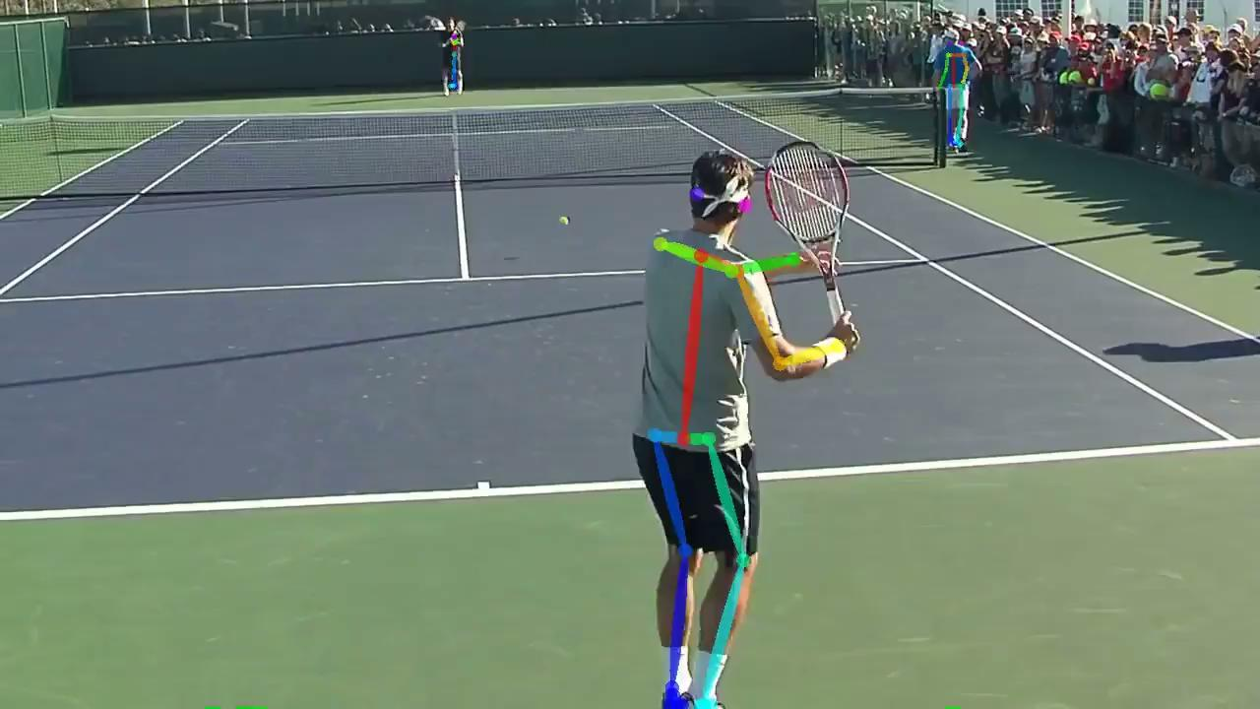
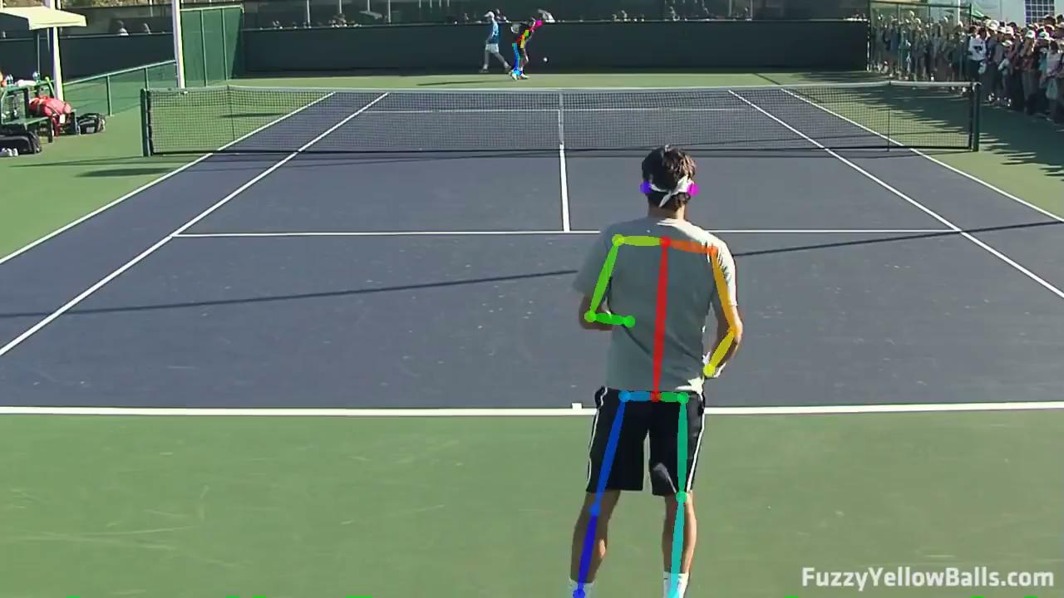
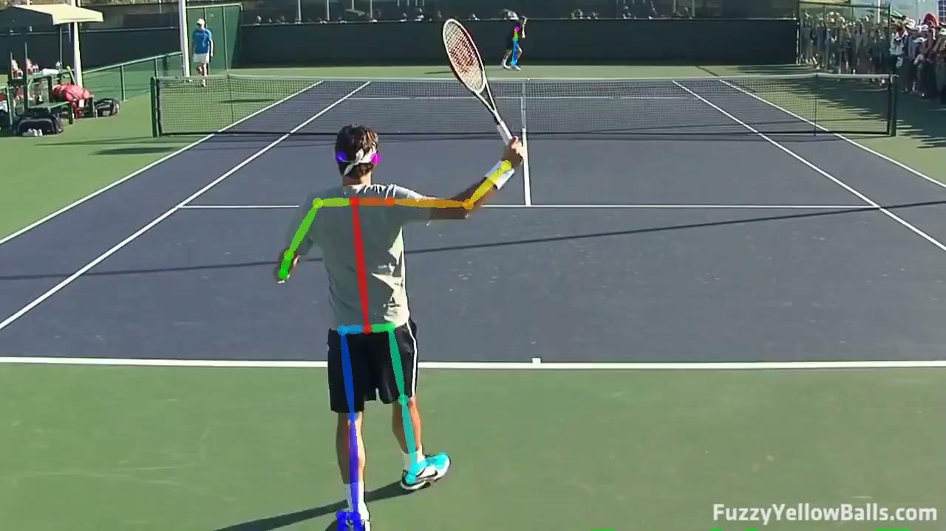
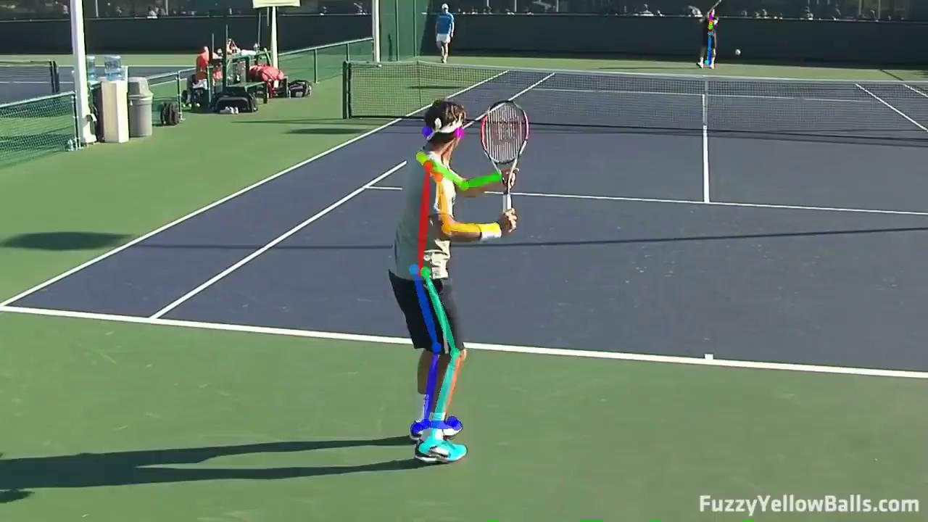
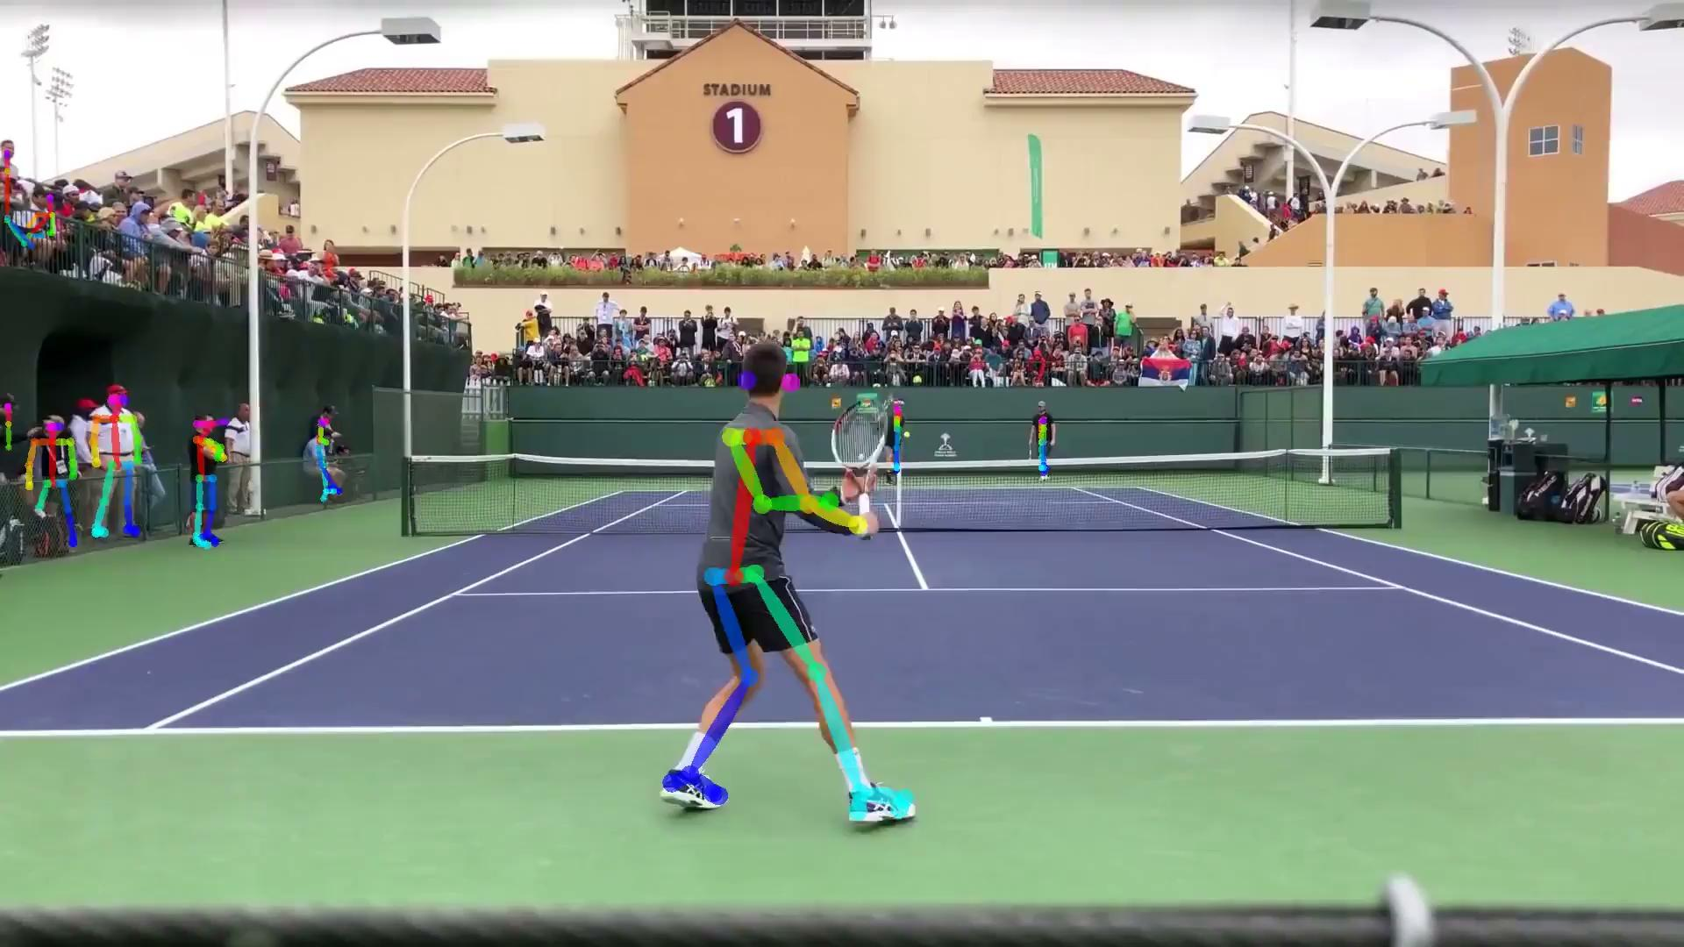
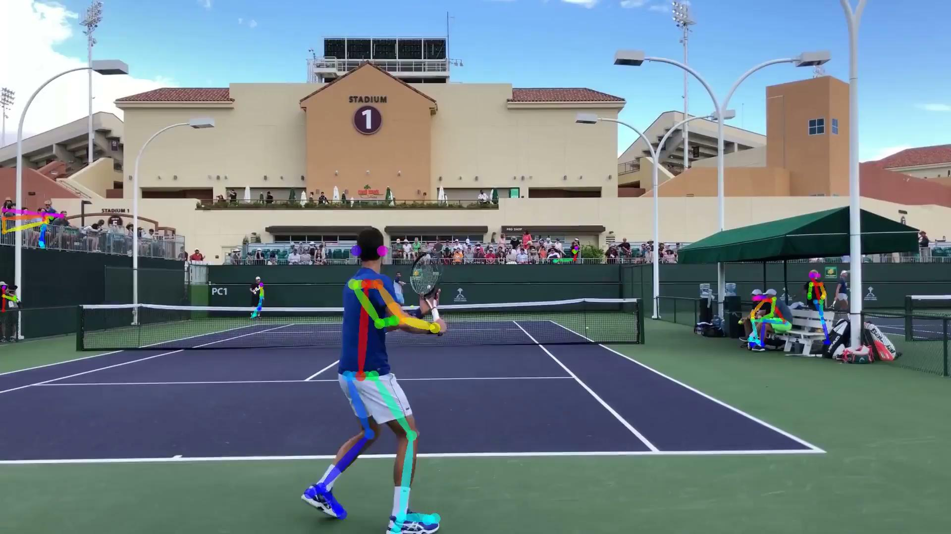
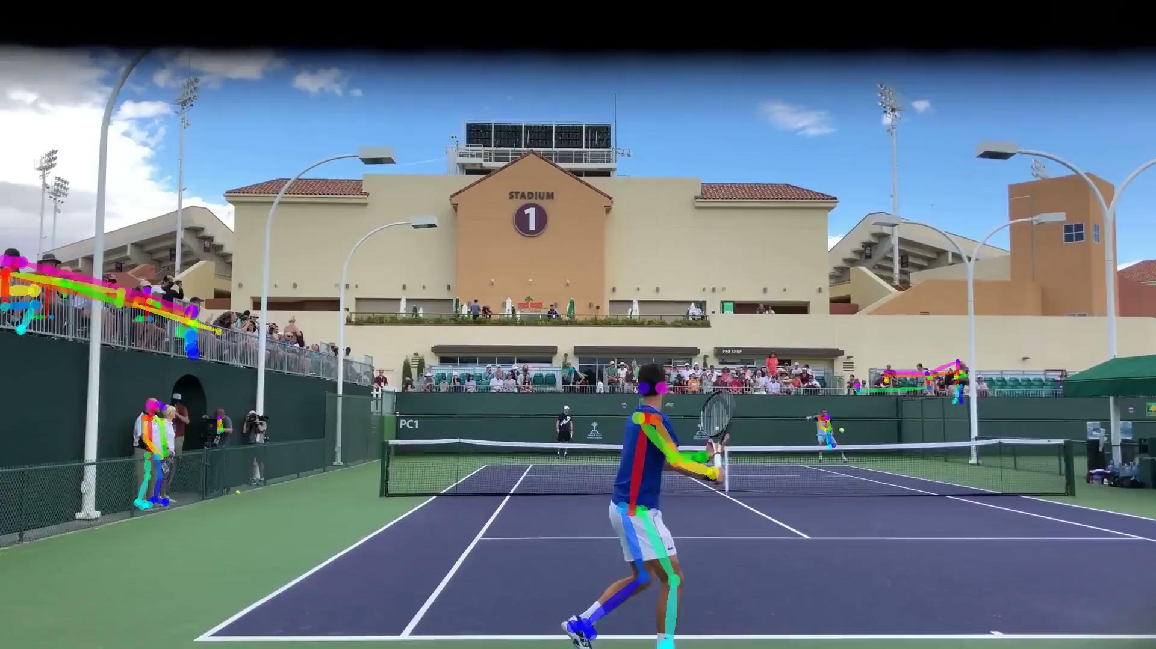
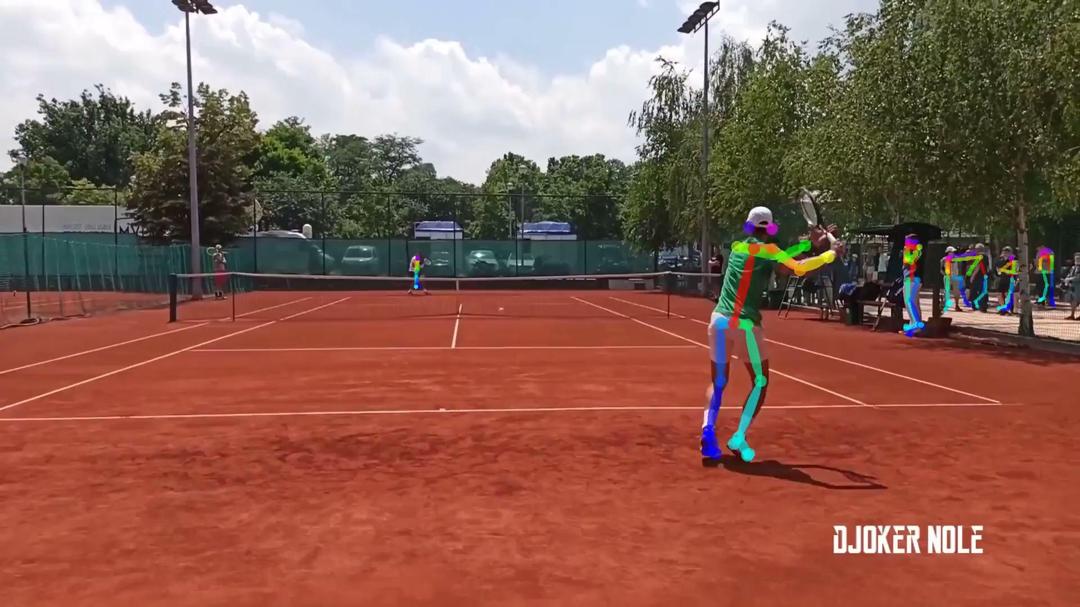
Data Collection

Slide 6
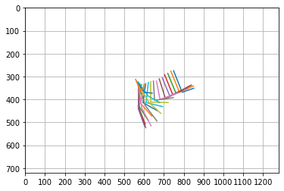
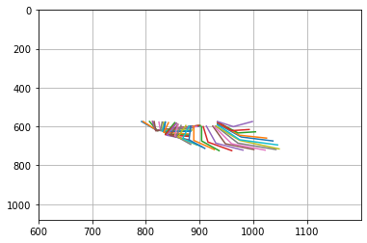
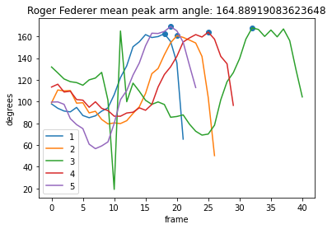
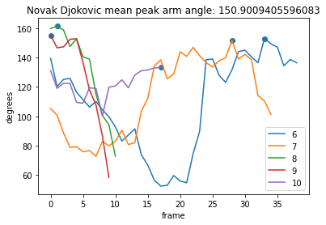
Comparing Peak Arm Angle during Forehand
Example Arm Motions:

Slide 7
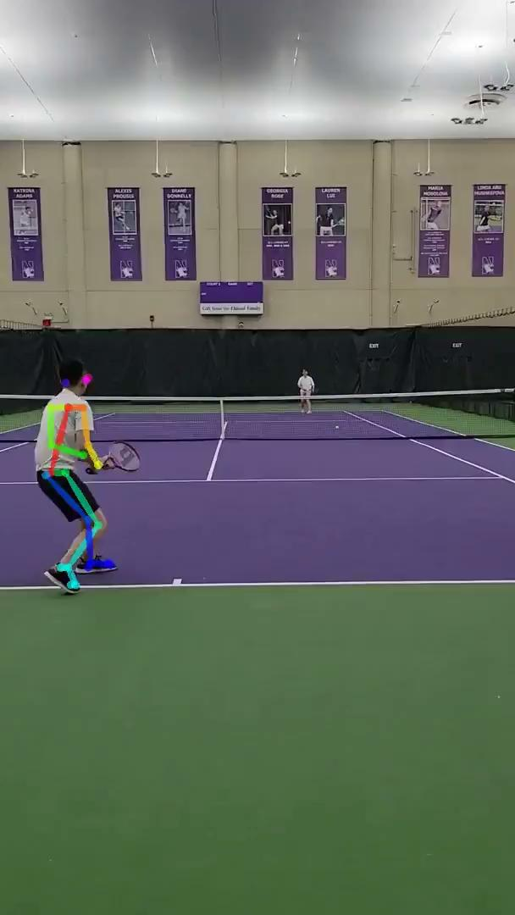
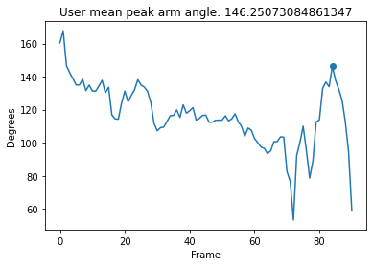
Example Novice Player
Most similar to: Novak Djokovic

Slide 8
Next Steps
Calculate stronger heuristics to provide better automation
Expand database to include more professional players
Include time as a dimension to better capture contact with the ball along with ball tracking
Improve user interactivity and usability
Progress to other components of a player’s profile, e.g. movement, posture, contact angle, shot selection, serves, etc.

